Slide 1


EMerging Trends in Edge computing
Aayush Ahuja -01
Vanshika Keshwani -43
Parth Verma -70
-
-

Slide 2
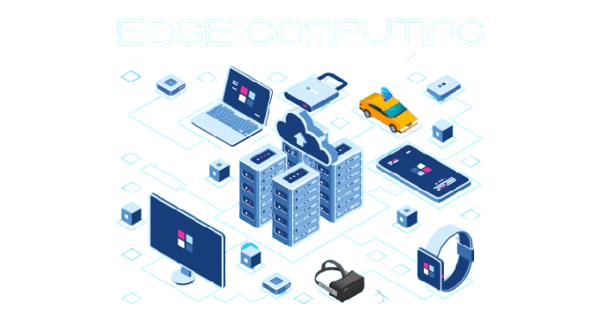
INTRODUCTION TO EDGE COMPUTING
Definition: Processing data near the source instead of cloud data centers.
Purpose: Reduces delay, saves bandwidth, and enables real-time processing.
Key Drivers:
IoT growth
Low-latency needs (AR/VR, self-driving cars)
Data-heavy apps (smart cities, streaming)

Slide 3
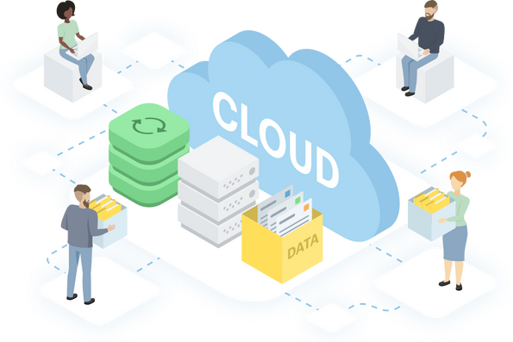
EDGE COMPUTING VS CLOUD COMPUTING
• Edge Computing:
•- Decentralized processing at network edge
•- Low latency, real-time response
•- Best for time-sensitive applications
Cloud Computing:
•- Centralized processing in data centers
•- Higher latency due to distance
•- Scalable but not ideal for real-time tasks

Slide 4
KEY EMERGING TRENDS
1. AI at the Edge
Traditionally, AI models require cloud processing, but edge computing enables AI/ML models to run directly on local devices.
Reduces response time and dependency on internet connectivity, ensuring real-time decision-making.
Example: Facial recognition in smartphones, predictive maintenance in industrial IoT.
2. 5G Integration
5G networks provide ultra-fast, low-latency communication, enhancing edge computing capabilities.
Enables real-time applications such as autonomous vehicles, remote surgeries, and smart manufacturing.
5G allows for seamless connectivity between edge devices, improving data transfer efficiency.

Slide 5
SERVERLESS EDGE COMPUTING
Definition:
Serverless computing at the edge enables the execution of functions on-demand without the need for managing infrastructure.
Benefits:
Reduces cost by eliminating the need for always-on servers.
Improves scalability, automatically adjusting resources based on demand.
Simplifies deployment and maintenance of edge applications.
Example:
Cloudflare Workers and AWS Lambda@Edge provide edge-based serverless execution for dynamic content delivery.

Slide 6
FOG EDGE COMPUTING
Definition:
A layer between the cloud and edge devices that helps process, analyze, and filter data closer to where it is generated.
Role in Edge Computing:
Reduces the burden on cloud resources by handling processing at intermediate nodes.
Enhances decision-making by providing localized data insights.
Use Case: Smart traffic management systems optimize signal operations based on real-time vehicle and pedestrian data.

Slide 7
EDGE-CLOUD ORCHESTRATION
Concept: Dynamic workload balancing between edge and cloud computing to maximize efficiency.
Advantages:
Ensures optimal use of resources by processing critical data at the edge while offloading non-critical tasks to the cloud.
Reduces latency and improves reliability.
Supports applications such as live streaming, content delivery, and industrial automation.
Example:
CDNs like Akamai and Cloudflare use edge computing to cache content closer to users, reducing load times.

Slide 8
SECURITY CHALLENGES AND TRENDS
Key Security Risks:
Data Breaches: Decentralized architecture increases the risk of unauthorized access and data theft.
Physical Security Threats: Edge devices are often deployed in remote or insecure locations, making them vulnerable to tampering.
DDoS Attacks: Edge networks are susceptible to distributed denial-of-service attacks that can disrupt services.
Emerging Security Solutions:
Secure Boot Mechanisms: Ensures only authenticated software runs on edge devices.
End-to-End Encryption: Protects data during transmission between edge, fog, and cloud layers.
AI-Driven Threat Detection: Uses machine learning to identify and mitigate security risks in real time.

Slide 9
FUTURE DIRECTIONS
Key Security Risks:
Data Breaches: Decentralized architecture increases the risk of unauthorized access and data theft.
Physical Security Threats: Edge devices are often deployed in remote or insecure locations, making them vulnerable to tampering.
DDoS Attacks: Edge networks are susceptible to distributed denial-of-service attacks that can disrupt services.
Emerging Security Solutions:
Secure Boot Mechanisms: Ensures only authenticated software runs on edge devices.
End-to-End Encryption: Protects data during transmission between edge, fog, and cloud layers.
AI-Driven Threat Detection: Uses machine learning to identify and mitigate security risks in real time.

Slide 10
REAL-LIFE EXAMPLES
🚗 Autonomous Vehicles –
Self-driving cars (e.g., Tesla, Waymo) process sensor data locally for real-time navigation.
🌆 Smart Cities –
Traffic signals and surveillance cameras analyze data on-site to optimize urban infrastructure.
🏥 Healthcare –
Wearable devices (e.g., smart insulin pumps) monitor patients and adjust treatments instantly.
🏭 Industrial IoT –
Factories (e.g., Siemens) use edge computing for predictive maintenance and efficiency.
📶 Content Delivery Networks (CDN) –
Platforms like Netflix cache content at the edge for faster streaming.

Slide 11
CONCLUSION
Edge computing
is transforming data processing by enabling decentralized, real-time analytics.
Emerging trends such as AI at the edge, 5G, and serverless computing are shaping its future.
Addressing security risks and optimizing power efficiency will be critical for mass adoption.
The future of edge computing lies in smarter hardware, energy optimization, and standardized frameworks.

Slide 12
THank you
-
-

